Slide 1
ONLINE BANKING APPLICATION
September 2022

Slide 2
Team mentor Roshni Dhakate
Team member
Kedar Watile
Lavanya Yadapally
Harshavarddhan
R S Chinmayee
Trakshay Balagotra

Slide 3
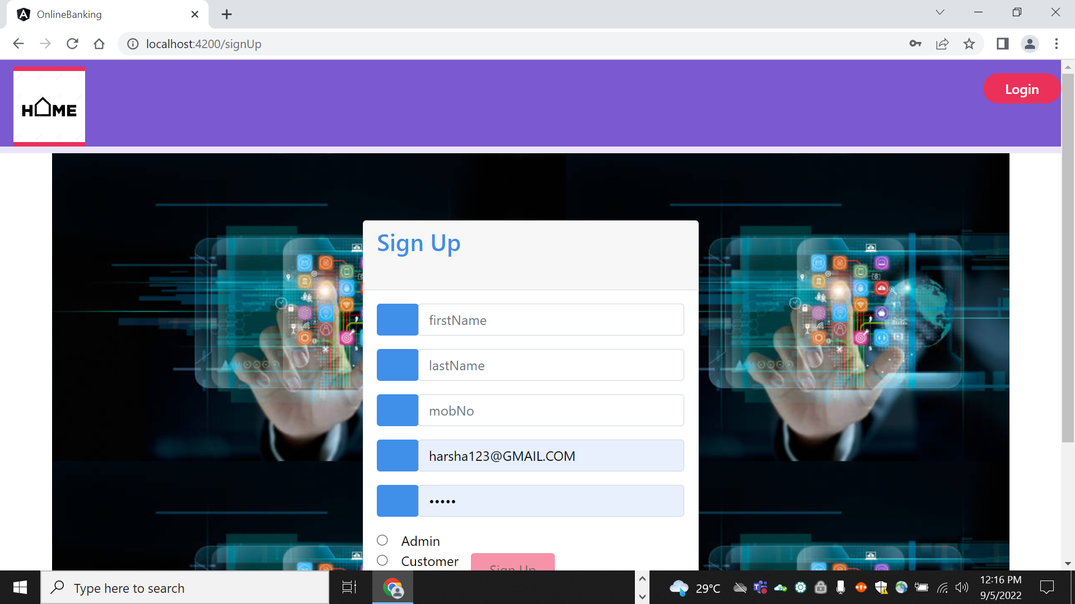
Features
An online banking app with admin and customer roles .
Account opening
Performing Credit operation
Performing Debit operation
Applying loan and processing it

Slide 4
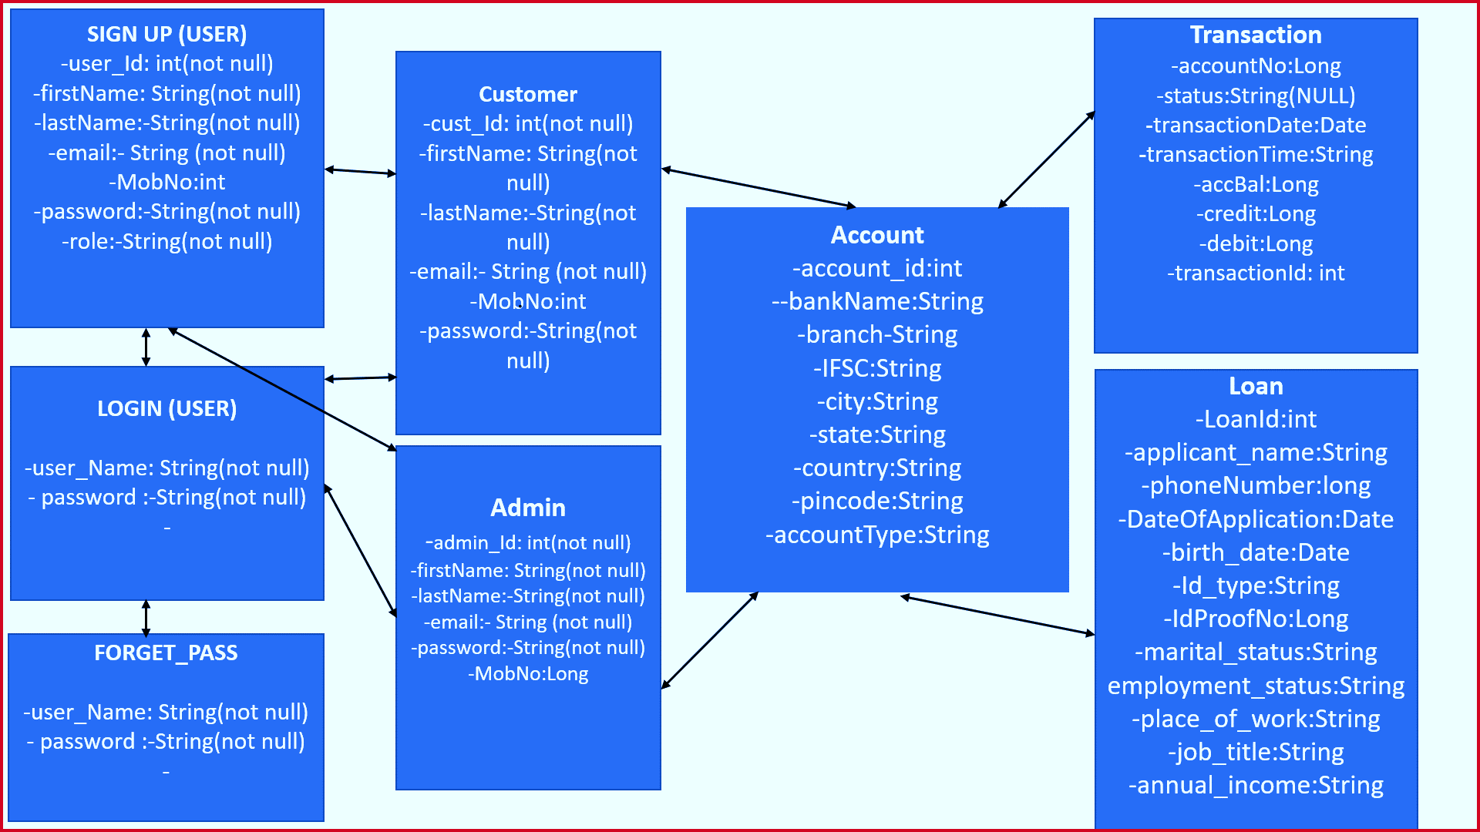

Slide 5
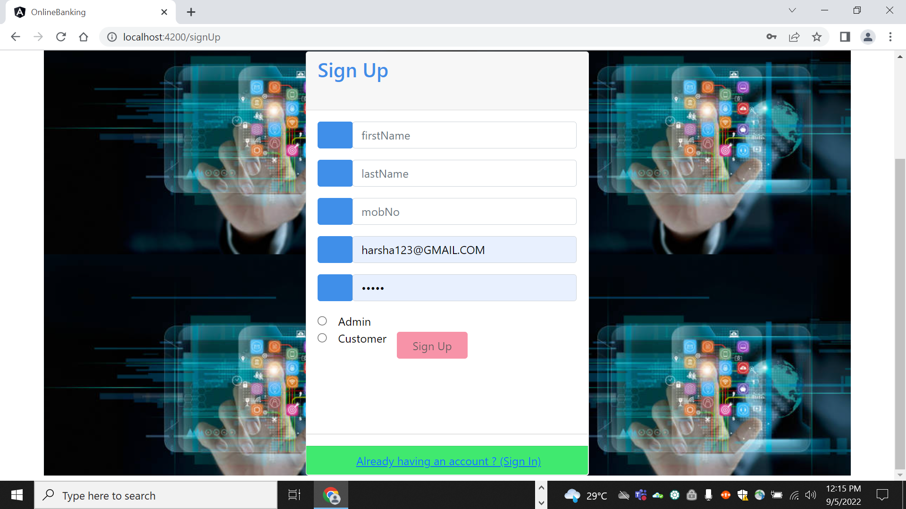

Slide 6
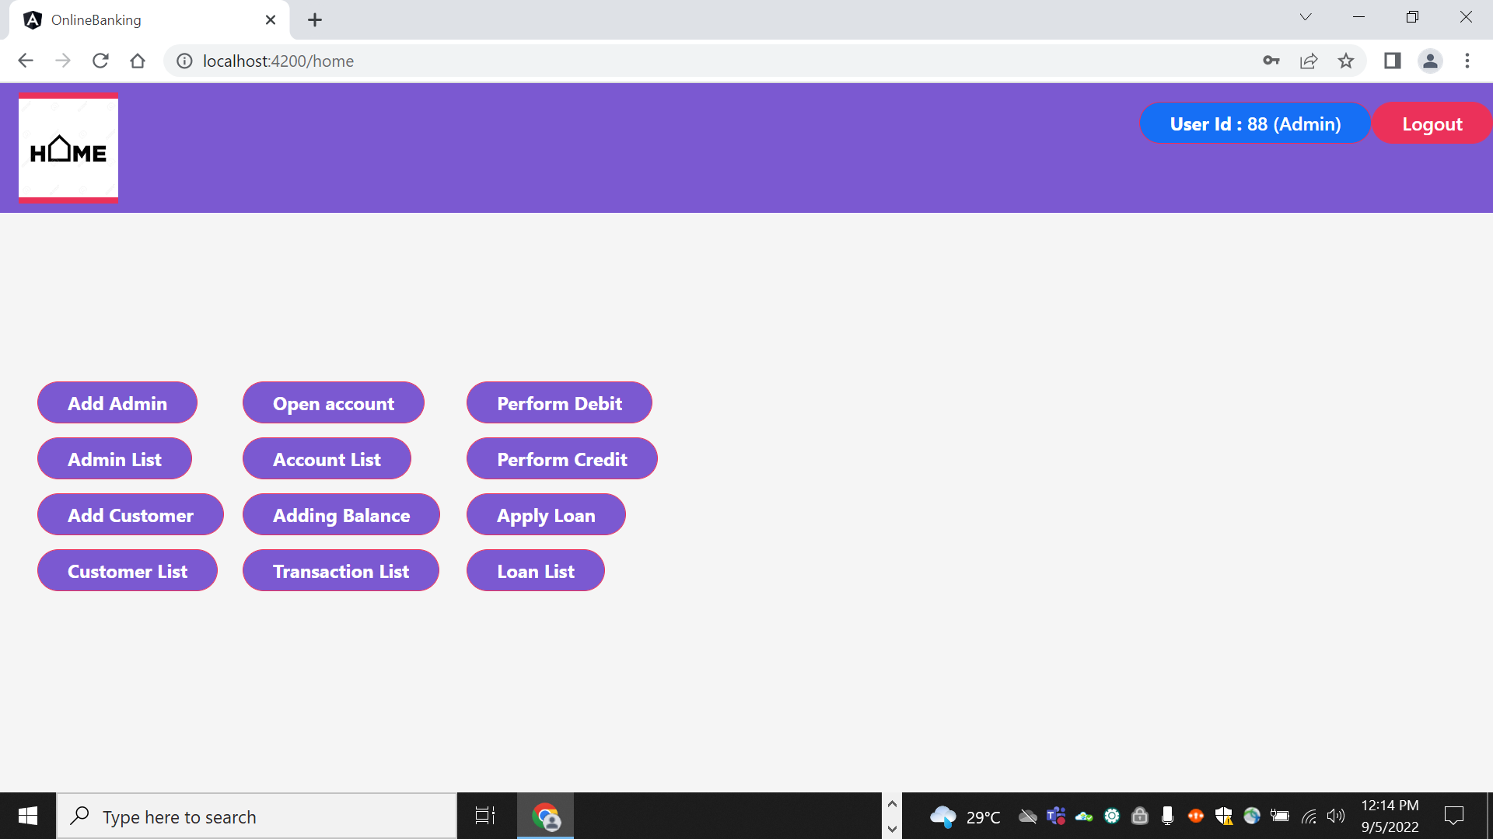

Slide 7
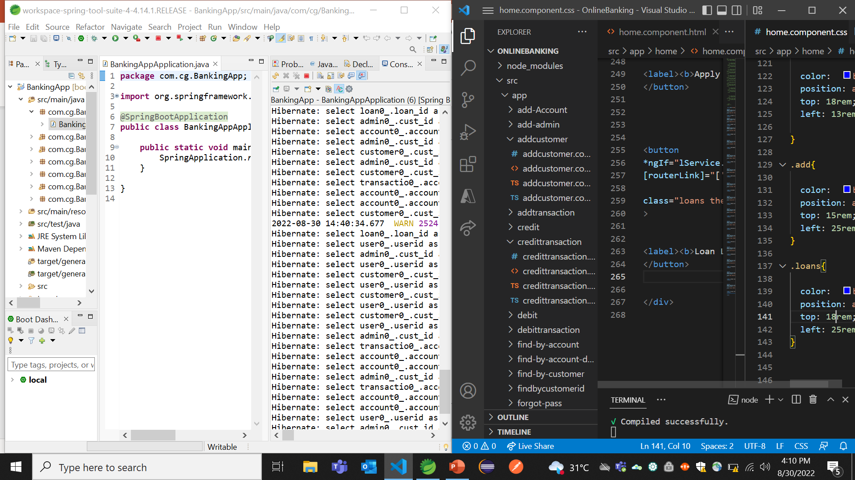




Tools
Spring Boot
Angular 7
Oracle 11g

Slide 8
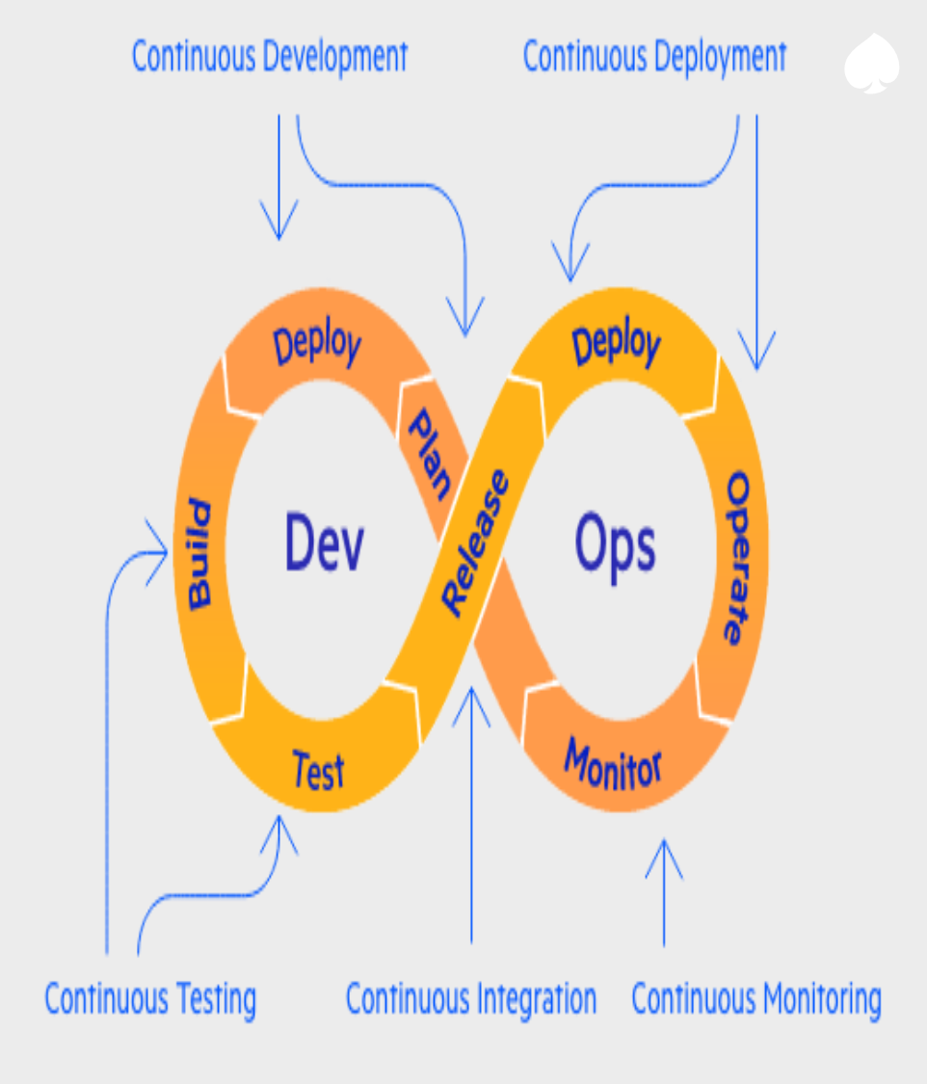
Future Scope
Creating a Super Admin Profile
Testing entire application with J-unit +angular test cases + selenium test cases
Deployment on AWS ( in pipeline)
Adding more functionality
Applying design and CSS stuffs to make it as per industry standards

Slide 9


Slide 10

GET THE FUTURE YOU WANT
capgemini.com

